Slide 1

Interfaith & the Feminine:
Rising Together
A Perspective on
Interfaith Spirituality for Polarized Times
Susan Wright
August 2024

Slide 2
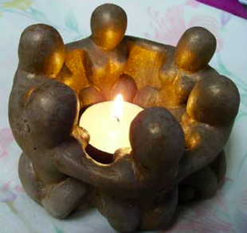
Outline
My interest and question
Some definitions
The Core Teachings
Commonalities
A Note on Leadership
Interfaith Feminine Leadership?
Two Examples
What’s Next?
“I AM the energy of the universe.”

Slide 3
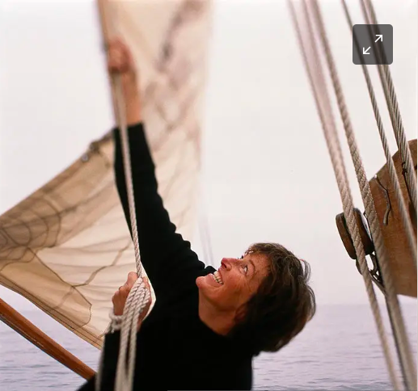
Why This Topic?
Revelation of “the feminine rising” out of our current dark night fire
“Spirit sends the breeze but we must lift the sail.”
What might a feminine interfaith sail lift into being?
How might that perspective shape our leadership in action?
“Beyond the illusion of certainty.”
Notes:
Revelation in 2018 that the feminine will rise to lead us through the fire of our current dark night.
Both a personal and a collective exploration. My need to reclaim my feminine – masculine centred life – and our need to reclaim the feminine in the world – patriarchy, war and oppression.
Here looking at the intersection of interfaith, the feminine and leadership to discern what we can learn and how we can take action.
NOTE: The feminine is an inclusive concept – like interfaith, “not about conversion but completion” (Imam Jamal). How can we be more complete human beings who create a more complete world?
Imam Jamal: lift the sail
Pastor Don: illusion of certainty
Me: Dark Night

Slide 4

What do I mean by the feminine rising?
“After thousands of years living in the shadow of the masculine… the media today is full of messages that it is time to listen to women’s wisdom.”
“Feminine Rising reveals a revolution in the making that is taking place online, in boardrooms, in voting booths, and on the streets.”
“Mother, Grandmother, Earth, may we walk lovingly and with mercy upon your paths. May we make peace with all our relatives.”
Notes:
In the last half dozen years, a sense of the feminine rising – quick look shows 8 books with “feminine rising” in the title – in response to global authoritarianism and its disproportional effects on women and girls.
1, Kathe Schaaf & Kay Lindahl
2. Amy Hudock
3. Lakota Prayer
These quotes examples of feminine as Mother Earth, as Divine Wisdom, as a revolution in action already happening
Also coming from interfaith perspectives:
Buddhist: Wisdom Rising: Journey into the Mandala of the Empowered Feminine
Lama Tsultrim Allione, 2018.
Indigenous: Red Rising Collective Issue 10: Matriarchy, 2020.
Kabbalah: Shekhinah and the Revival of Feminine God Language
Leore Sachs-Shmueli, Modern Judaism 30, 3, 2019.

Slide 5

What do I mean by interfaith?
Moving beyond ego; getting to know the Other as a human being; hospitality; living with uncertainty and paradox
Little by little, then a big leap; the line dividing good and evil runs through all of us; do the inconvenient inner work
The violence behind the violence: extremism; spiritual practice as “a portal to the infinite”, the search for common ground
Notes:
Selections that particularly stayed with me from each of the three amigos.
Theme of the importance of doing our own inner work, raising consciousness, as a fundamental component of interfaith – we must know ourselves before we can know the Other.

Slide 6
The Core Teachings
Interfaith
Feminine Rising
Activities or relationships among people with different beliefs or faith identities
Oneness
Unconditional Love
Compassion
A perspective and movement for changing socio-cultural structures of domination and exploitation.
Equality
Human Rights
Social Justice
  Schema! Listen! The Ineffable Infinite Breath of Life is One.
Notes:
Definition of Interfaith from Day 1 of Interfaith Summer School 2024
Definition of Feminine Rising from Patricia Hill Collins, intersectionality as Critical Social Theory
On first glance, not much in common but in fact very much the same ideas and goals, eg., Oneness leads to equality and Equality leads to a sense of Oneness, Unconditional Love leads to Human Rights and Human Rights lead to Loving the Other, etc.

Slide 7
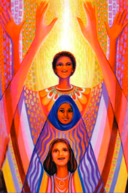
The Commonalities
Context:
Patriarchy – ego, power, control, sovereignty
Violence – individual and collective abuse and annihilation
Focus:
Universal in particular – unity in diversity
Awareness – conscious inner work leading to individual and social action
Dialogue – getting to know the ‘Other’ at the intersections
“One divine presence wrapped in a variety of garments.”
One
Notes:
The context of what Pastor Don calls, “patriarchy, hierarchy and superstition” and the exercise of power over through violence.

Slide 8

A Note on Leadership
Leadership = “anyone who is willing to help.” (Meg Wheatley)
AND
Co-creative – strength is in the diversity and complexity of the web
Holographic – vision of the whole, the DNA, is embedded in each of the parts
Heterarchical – leadership is shared, step up when you hear the call
Interdependent – value of relationships, wisdom circles, sacred synergy
Notes:
Meg Wheatley – women have always been leaders, collaboratively helping where there is need, often behind the scenes occupied by the masculine.
Also helpful to have a few frames to shape feminine leadership – there is a difference, a feminine way of knowing and being that values the capabilities and relationships. Beyond ego to eco, more attuned to nature and nurture, the earth.
Leadership principles from Wright & MacKinnon, Leadership Alchemy

Slide 9
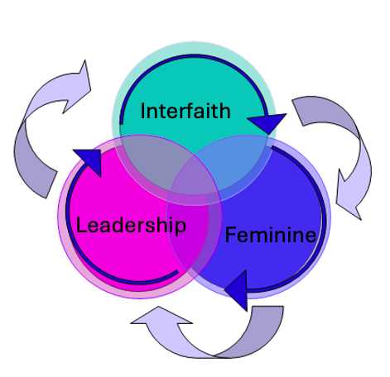
Directions for interfaith feminine leadership
Bringing intersectional feminism to interfaith
  Critical theory and social activism
Bringing Spirit to intersectionality
  Compassionate dialogue on difficult issues
Connecting across new boundaries
  Class, race, sexuality, location, social action
Opening opportunities for relationship
  Collaborative communities of common
  interest
  Developing leaders across domains
Notes:
Looking at the hologram from different points of view in an extended web
To see what difference it makes, what opportunities open up.
All is embedded in each so action takes place on many fronts in many ways, all contributing to the whole
Messy but effective requisite variety.

Slide 10
Two Examples
Gangjeong Village, Jeju
Right Relations Collaborative
Women protesting a naval base: peace activism informed by feminine activism
Peace concerts, story, marches, art, religious services, and 100 peace bows
“Women embody interfaith spirituality every day,” leading, feeding and caring for other activists
Opening a courageous space for peace, justice and emancipation
Non extractive sources of funding for Indigenous communities here in BC
Aunties Council raising awareness and meeting needs of local women and children
Youth reclaiming ancestral culture and spirituality in summer camps on the Land, dancing and woodworking
Intergenerational community building and restorative justice
Notes:
Gangjeong Village: Keun-Joo Christine Pae, Feminist Activism as Interfaith Dialogue: A Lesson from Gangjeong Village of Jeju Island, Korea, Journal of Korean Religions 5,1, 2014.
Right Relations Collaborative, https://rightrelationscollaborative.ca/.

Slide 11

Interfaith Feminine Leadership From Here?
Good News: A thousand points of light!
Bad News: Below the surface
Agenda: Feminine Interfaith Uprising:
* share ideas across boundaries
* support each other’s inner work
* civil disobedience, courageous spirituality
* periphery becomes centre – Womanist, LGBTQI+, disabled, underprivileged, youth and elders
Raise our sails together – time is short!
“Everything, Everything, Everything is Holy Now”
Notes:
Some good and bad news – leads to an agenda, an uprising across boundaries – outsiders become insiders leading the way.
Peter Mayer, Everything is Holy Now.

Slide 12
References
Lama Tsultrim Allione, Wisdom Rising: Journey into the Mandala of the Empowered Feminine, 2018.
Patricia Hill Collins, intersectionality as Critical Social Theory, 2019.
Rachel A. Heath, “Lessons in Multifaith Chaplaincy and Feminist Thought: Making Room for Multiple Religious Belonging in Interfaith Praxis,” The Journal of Interreligious Studies 20, 2017.
Amy Hudock, Feminine Rising: Voices of Power and Invisibility, 2019.
Lakota Prayer Ceremony, Parliament of the World’s Religions, 2023.
Pastor Don Mackenzie, Rabbi Ted Falcon, Imam Jamal Rahman, Religion Gone Astray: What we Round at the Heart of Interfaith, 2011.
Peter Mayer, Holy Now, https://www.youtube.com/watch?v=KiypaURysz4.
Oscar Momanyi,” The Children of Sarah, Hagar and Mary: A Feminist Perspective on Judaism, Islam and Christianity,” The Way 56/2, 2017.
Keun-Joo Christine Pae, “Feminist Activism as Interfaith Dialogue: A Lesson from Gangjeong Village of Jeju Island, Korea,” Journal of Korean Religions 5,1, 2014.
Red Rising Collective Issue 10: “Matriarchy,” 2020.
Right Relations Collaborative, https://rightrelationscollaborative.ca/.
Leore Sachs-Shmueli, “Shekhinah and the Revival of Feminine God Language,” Modern Judaism 30/3, 2019.
Kathe Schaaf & Kay Lindahl, “The Divine Feminine Emerging, Embodied, and Emboldened,” The Interfaith Observer, Fall 2023.
Sarah Robinson, “Rosemary Radford Ruether’s Global Scope in Interfaith Reconciliation,” Feminist Theology 31/3, 2023.
Rosemary Radford Ruether, “The Development of Feminist Theology: Becoming Increasingly Global and Interfaith,” Feminist Theology 20/3, 2012.
Susan Wright, Dark Night: Reclaiming the Other on the Journey to Wholeness, 2020.
Susan Wright and Carol MacKinnon, Leadership Alchemy: The Magic of the Leader Coach, 2013.

